Slide 1
Boy Scout Troop 58 An Overview January 2017

Slide 2
Agenda
Boy Scouting – an overview
Troop 58
Overview
Leaders
Activities
Service
Discussion/Q&A

Slide 3
Setting The Stage
BSA Mission: Prepare young people to make ethical and moral choices over their lifetimes by instilling in them the values of the Scout Oath and Law
BSA Vision: Prepare every eligible youth in America to become a responsible, participating citizen and leader who is guided by the Scout Oath and Law
Scout Oath: On my honor I will do my best, to do my duty, to God and my country, and to obey the Scout Law; to help other people at all times; to keep myself physically strong, mentally awake, and morally straight.
Scout Law: A Scout is Trustworthy, Loyal, Helpful, Friendly, Courteous, Kind, Obedient, Cheerful, Thrifty, Brave, Clean, and Reverent

Slide 4
Setting The Stage (continued)
Boy Scouts of America
Other Councils
National Capital Area Council
Other Districts
Goose Creek District
Troop 58
Other Troops/ Packs/Crews

Slide 5
Differences Between Cub Scouts & Boy Scouts
 | Cub Scouts | Boy Scouts
Organization | Den/Pack | Patrol/Troop
Leadership | Adult led | Scout led / adult supervised
Advancement | Collective advancement | Self paced
Parental Involvement | Run an outing annually, help with events, leadership roles | Assist the troop: driving, YPT, leadership roles, committee
Camping | Parents required | Parents encouraged
Lessons | Adults teach lessons/skills | Scouts teach lessons/skills
Chain of command | Parents, Den Leader, Cubmaster | Patrol Leader, Senior Patrol Leader, Adults
Learning expectation | Do Your Best | Mastery
Gear | Mom & Dad pack | Scout packs

Slide 6
Things Our Scouts Learn
How to follow the Scout Oath and Law
Life lessons
Avoiding to fail a 2nd time
Setting goals; develop and apply a plan to achieve them
The importance of taking care of our environment
Leadership skills
i.e., delegation of authority, but not responsibility

Slide 7
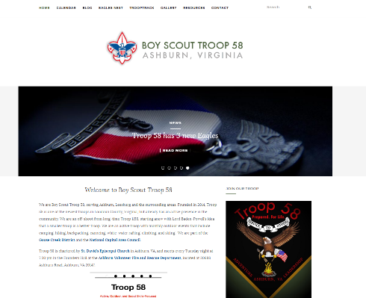
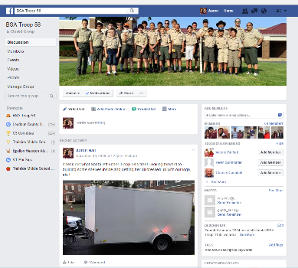
Troop 58 At-A-Glance
Founded: January 2014 (off-shoot from another Ashburn unit - Troop 1158)
Online presence
http://http://troop58ashburn.camp/
https://www.facebook.com/groups/459655690829027/
Youth members: 39 (as of December 2016)
Registered adult leaders: 18
Weekly Troop meetings, monthly outings, quarterly Courts of Honor
We are an active, outdoor, and Scout skills-focused Troop

Slide 8
Key Leaders/Roles
Adult
Scoutmaster (guides the youth leaders of the Troop) – James Rogers
Multiple Assistant Scoutmasters
Committee Chair (manages the Troop) – Jen Peiler
Multiple Committee members
Youth
Senior Patrol Leader (SPL) / Asst. SPL (leads the Troop): Jack Entsminger / Michael Boyd
4 Patrols with Leaders
Eagles
Spartans
Stags
Watchdogs
Other positions: Chaplain Aide, Instructor, Quartermaster, Scribe, Historian, etc.

Slide 9
Troop 58 Adult Organization
James Rogers
Scoutmaster
Jigar Parikh
Joe Meree
Assistant Scoutmasters
Aaron Hall
Kevin Reed
Jigar Parikh
Merit Badge Counselor Coordinator
Billy Sylvester
Kim Moore
Scott Palmer
Ryan Palmer
Daniel Van Hulle
Dylan Reed
Assistant Scoutmasters
Additional Roles
Kevin Reed
Eagle Advisor
Aaron Hall
Chaplain
Aaron Hall
Outing Lead
Tom Bonina
Summer Camp Lead
David Weitzel
Chartered Organization Rep
Jen Peiler
Committee Chair
Chairs
Tina Boyd / Bob Petro Advancement
Bob Lawrence
Thrift Closet
Kavita Parikh
Medical Records
Bhavana Bhaumik
Membership Chair
Rick Entsminger
Training
Sharin Harun
Secretary
Wilson Chua
Treasurer
John Footen
Webmaster
TBD
Fundraising
Chairs
Aaron Hall
Communications/PR
TBD
Friends of Scouting
Bhavana Bhaumik
Scouting for Food
TBD
Recruiting
Aaron Hall
Adult Recognition
Sarvani Mallemudi
Equip. Coord.

Slide 10
Major Recent Outdoor Activities
2014
April: Backpacking
May: Riflery
June: Bike hike
July: Summer camp (Camp Saffran, MD) and High Adventure camp (Sea Base, FL)
September: Whitewater rafting
October: Scout skills
December: Hiking
2015
January: Ski Trip and Freeze-o-ree campout
February: N/A (weather cancellation)
March: Sport-Rock Climbing Lock-in
April: Backpacking trip
May: New Scout campout, Riflery campout
June: C&O Canal Bike Hike campout
July: Summer Camp (Camp Ockanickon, PA) and High Adventure camp (Bechtel Summit, WV)
August: Lake Campout
September: Canoeing
October – December: monthly campouts
2016
January: N/A (weather cancellation)
February: Skiing trip to Whitetail Ski Resort in Mercersburg, PA
March: SportRock climbing overnighter in Sterling, VA
April: Shooting campout in Manassas, VA
May: Whitewater Rafting campout on the Youghiogheny River in Ohiopyle, PA and New Scout campout in Ashburn, VA
June: week-long Boy Scout summer camp @ Goshen, VA
July: Biking campout along the C&O Canal tow path from Leesburg, VA to Washington, DC (~50 miles)
September: Patrol Challenge outing at the Blue Ridge Environmental Center in Purcellville, VA
October: Scout Skills campout at Sky Meadows State Park in Delaplane, VA
November: Hiking campout at Elizabeth’s Furnace in Fort Valley, VA

Slide 11
Major Service Activities
2014
April: Mobile Hope
June: Patriot Cruise and Salute
November: Scouting for Food
Several individual Eagle Scout service projects
2015
Supported the Virginia Wine Country Half Marathon
Helped prepare the Community Church’s facilities for its annual summer camps
Participated in the Ashburn Village 4th of July parade
Collected 212 lbs. of food for the needy during the annual Scouting for Food event
Several individual Eagle Scout service projects
2016
Led Scout Sunday activities for the Troop’s Chartering Organization – St. David’s Episcopal Church
Supported St. Theresa Catholic Church’s You(th) vs. Hunger event
Supported the Virginia Wine Country Half Marathon
Participated in the Ashburn Village 4th of July parade
Held an extensive facility and site beautification service project for St. David’s Episcopal Church
Began ongoing lawnmowing service for the Ashburn Volunteer Fire Department
Collected 297 lbs. of food for the needy during the annual Scouting for Food event

Slide 12
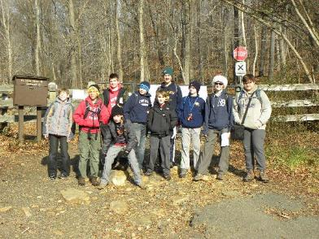
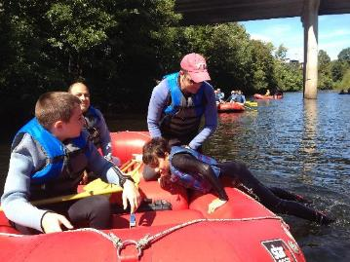
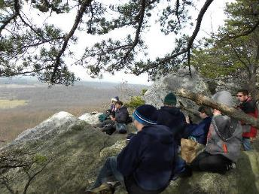
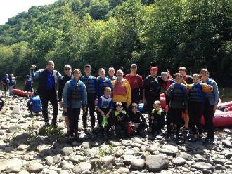
Troop 58 in Action

Slide 13
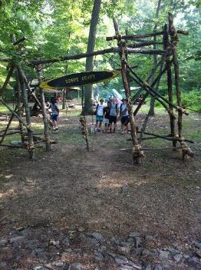
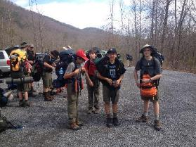
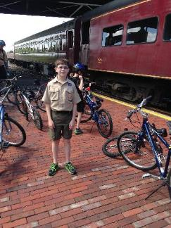
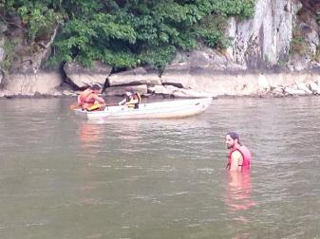
Troop 58 in Action

Slide 14
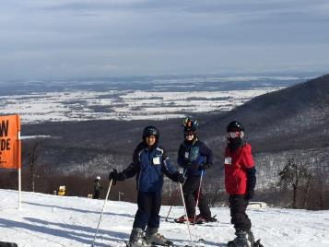
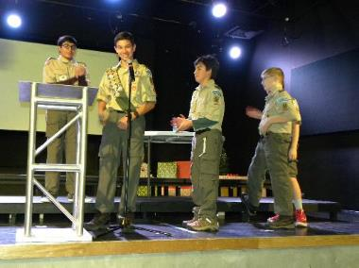
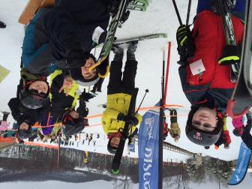
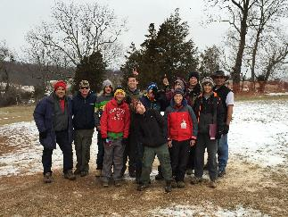
Troop 58 in Action

Slide 15
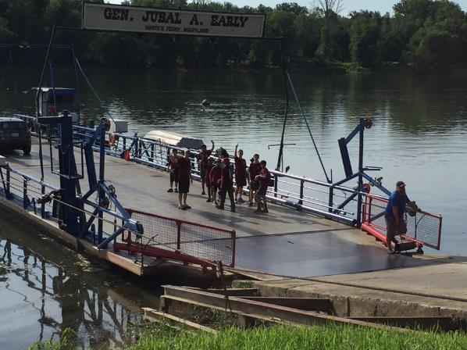
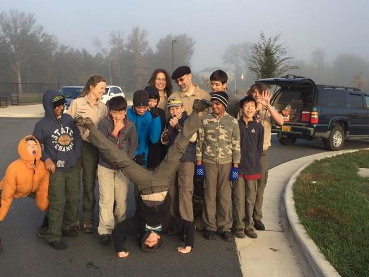
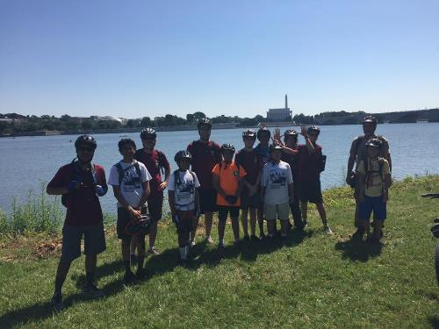
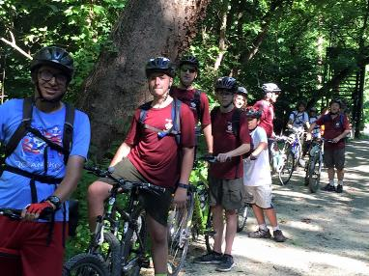
Troop 58 in Action

Slide 16
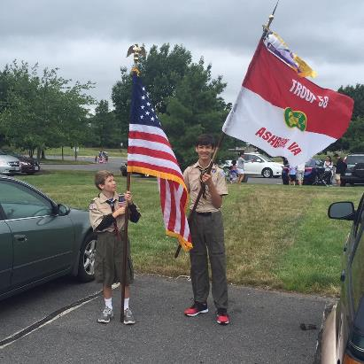
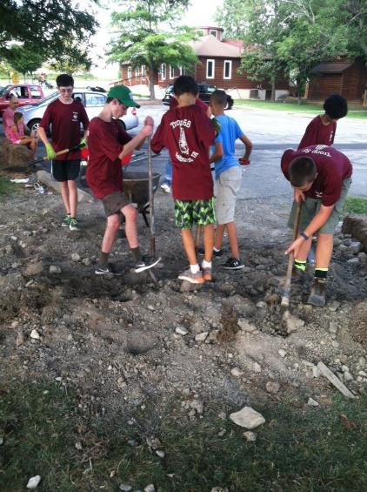
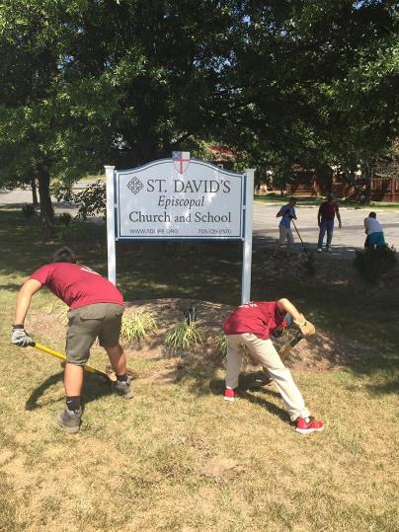
Troop 58 in Action

Slide 17
Discussion/Q&A
Notes:
Storage space on the church/school property?

